Slide 1
Camunda Cloud
Code Studio
hosted by your favorite Developer Advocates

Slide 2


Your hosts for this session
Thomas Heinrichs
Developer Advocate
Josh Wulf
Developer Advocate

Slide 3
About Camunda and this workshop
Get to know each other and brainstorm processes
Break
Let’s try out Camunda Cloud
Deploying a process with user tasks
Implementing your first client for Cloud
Break
Adding more complexity to your process
Generate awesome dashboards in Optimize
Hangout & Beer
End

Slide 4
Orchestrate. Automate. Transform.
JANUARY 2022
Notes:
I’d like to start by introducing Camunda and telling you about what we do
Abstract for the “Orchestrate. Automate. Transform.” presentation:
Many organizations struggle to build scalable, resilient automation of complex business processes that span across people, systems, and devices. In particular, the integration of legacy systems and homegrown applications is time-consuming and requires extensive developer resources. In this talk, we’ll see how Camunda allows business users to collaborate with developers to model and automate end-to-end processes that run with the speed, scale, and resiliency required to compete in today’s digital-first world. With Camunda, organizations can design, automate, and improve processes that drive business growth and deliver great customer experiences.

Slide 5
About Camunda
2008
300+
100,000+
Founded
Employees Globally
Community Members
6
500+
190+
Offices Worldwide:
America, Asia, and Europe
Enterprise Customers
Countries with people using Camunda
Notes:
We started as a consulting agency focusing on process automation from day one – but after seeing the need for a strong process automation solution for companies across industries, we changed our direction to focus on building software
We’re a distributed organization with over 300 employees and six offices worldwide
Today, we have over 500 enterprise customers using our technology to run their mission-critical business processes
We also have a large developer community that’s part of our open-source ecosystem

Slide 6
Common Camunda Uses
Top uses of Camunda across three areas of work
IT Initiatives
Technical Use Cases
Business Processes
Building a centralized process automation platform
Replacing a legacy business process management (BPM) suite
Replacing homegrown workflow technology
Moving applications to the cloud
Human workflow automation
Microservices orchestration
RPA bot orchestration
Decision automation
Document management
Customer onboarding and data management
Order management
Claims management
Loan origination
Risk management and underwriting
Notes:
We like to look at the usage of our software in three dimensions:
Cross-department IT initiatives like replacing legacy software or moving applications to the cloud
Technical problems that need to be solved, like how to orchestrate microservices or how to automate decisions
And core business processes that are often undergoing digital transformation, like customer on-boarding, insurance claim management, loan origination, etc.
Here you can see some examples, but we have customers that use Camunda software for many different types of initiatives and use cases

Slide 8
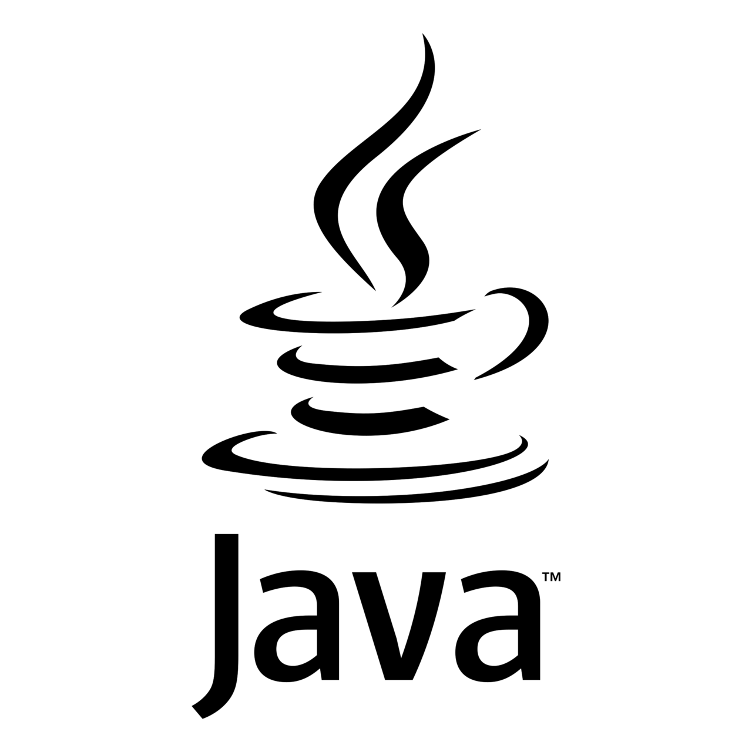







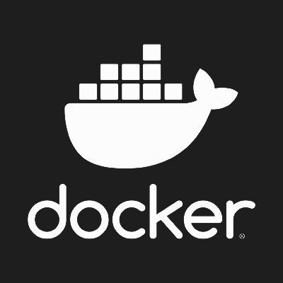
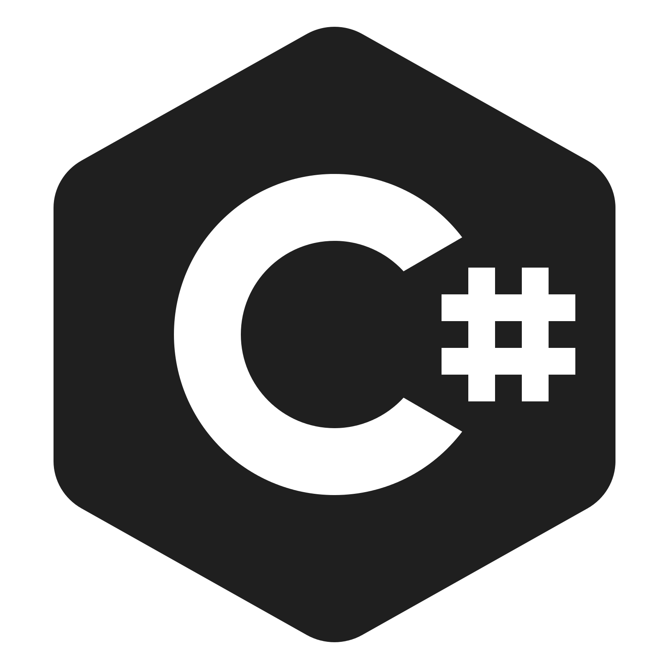


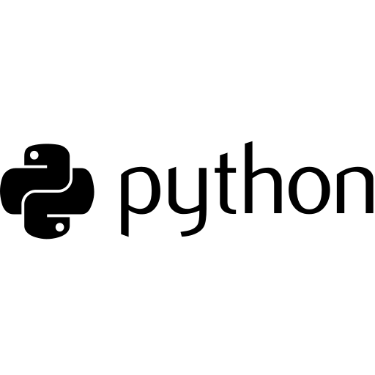

Code + deploy in your preferred language and tooling.
Run on your preferred platforms.
Across all endpoints.
Human Work
AI
Business Rules
Microservices
RPA
API
IoT
Notes:
We call our approach to process orchestration “universal” because we can orchestrate business processes, from start to finish, across a wide variety of endpoints
That includes everything from your legacy systems, to your next-generation microservices, plus your RPA bots, Internet of Things devices, and manual tasks
Because business processes are complex, we believe it’s critical to enable software developers and other IT users to deliver process automation projects by writing code in any programming language, working in their preferred Integrated Development Environment, using their existing CI/CD pipelines, and deploying to a variety of platforms – whether on premises or or in the public, private, or hybrid cloud

Slide 9

Camunda Cloud: The Universal Process Orchestrator
Design
Automate
Improve
Developers & business users collaborate to design, connect & deploy processes with Camunda.
Enterprise-grade automation platform. Built for today’s business complexity, loved by developers.
Operations teams access the insights needed to improve processes.
Modeler
Model & deploy business process diagrams with BPMN & DMN.
Available via web and desktop app.
Zeebe
Next-generation cloud-native workflow engine that unlocks unparalleled speed, scale & resilience. Open source SDKs in your preferred programming language brings the extensibility you need for your complex business processes.
Optimize
Get the insights you need to understand and continuously improve your business processes.
Tasklist
Assign and execute tasks that require human interaction via easy-to-use Forms or via your own apps with the Tasklist API.
Connectors
Integration Framework
Forms
Operate
Real-time visibility to monitor, analyze and resolve problems with any process instance.
Out-of-the-box integrations to easily communicate with popular enterprise applications & protocols.
Build & provision your own connectors to any system including homegrown & legacy applications.
Drag & drop creation of forms that power workflows that require human interaction.
Notes:
What we build is a universal process orchestrator that can automate any process, with any number of components and endpoints, deployed anywhere
We think about process orchestration in terms of a lifecycle
Starting with tools that help software developers and business users collaborate to design processes
Teams use our Modeler tool to design processes using the BPMN standard and implement business rules using the DMN standard
They can also use Modeler to quickly build user task forms for workflows that require human interaction
We’re also rolling two powerful new ways that you can connect Camunda to the other tools and systems in your technology stack
Out-of-the-box connectors will make it easier than ever to design fully integrated processes
And an integration framework will let software developers build their own connectors that can be reused across teams
Once you’ve collaboratively designed your processes, you can start automating them in a high-performance way
Our next-generation workflow engine, Zeebe, is designed for speed, scale, and resilience; which means your processes will be both fast and reliable
We also offer a web application for implementing tasks that require human interaction
And a web application for monitoring running processes so you can troubleshoot them effectively
Finally, once you have processes running, we use your real process data to provide comprehensive analytics that guide you toward continuous improvement of your process’ performance – ultimately, so you can deliver better and better experiences to your end users and customers
Note: If you need a Camunda Platform 7 version of this slide, visit https://docs.google.com/presentation/d/1c-Hkx60u9lJVuu0dfaBXKcY61qjUrMuIUQYvUSUWSCg/edit?usp=sharing

Slide 10
Get to know each other in breakout rooms
Exercise:
What process would you choose to help the health department to get more efficient?

Slide 11

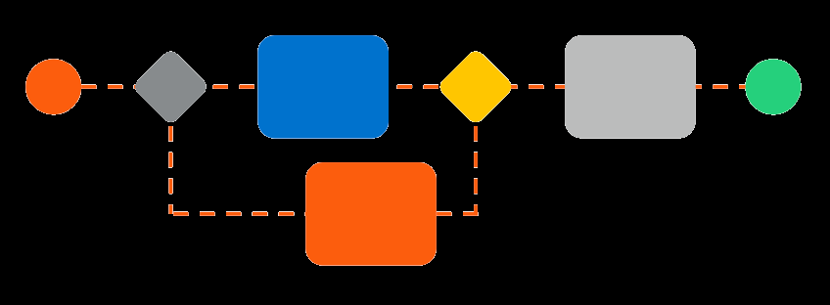
Let’s start modelling your ideas!

Slide 12

Try out Camunda Cloud

Slide 13
Deploying a process with user tasks Implementing your first client for Cloud Adding more complexity to your process Generate awesome dashboards in Optimize

Slide 14

Leave Feedback: camunda.com/contact
Notes:
Tomorrow you’ll receive a link with the recording of today’s sessions as well as the presentation slides if the speakers made them available to distribute.
Click next slide.

Slide 15

Now you have earned yourself a Beer
<survey>
Leave some Feedback!
Well done and thanks a lot for participating in this workshop!

